Slide 1
Smartwatch Analysis Using Python and Web Scraping
Anwar Basha

Slide 2
Introduction
Smartwatches combine advanced technology with convenience, offering features like fitness tracking, notifications, and more. Their design and functionality cater to both lifestyle needs and technological preferences.
This project involves extracting smartwatch data, including specifications and customer ratings, from an e-commerce website using web scraping and regular expressions to filter relevant information.
The data is then cleaned to handle missing values, followed by brand-wise analysis to identify the top-performing brands.

Slide 3
Objective
Identifying Market Trends
Evaluating Product Performance
Enhancing Customer Insights
Optimizing Pricing Strategies
Informing Brand Strategies
Understanding current trends in smartwatch features, designs, and pricing to align with consumer preferences.
Assessing the performance and specifications of various smartwatch models to determine their strengths and weaknesses
Gaining insights into customer preferences and buying behavior to inform product development and marketing strategies
Analyzing price points and value propositions to recommend competitive pricing and maximize profitability
Providing actionable data to brands for strategic decision-making, including product features, design choices, and market positioning

Slide 4

Tools and Technologies used
Python
BeautifulSoup
Pandas
Numpy
Matplotlib
Seaborn

Slide 5
Data Collection Process
Websites targeted for data scraping is Flipkart.com
List of Features scraped
Title | Strap Color | Display Resolution | Internal Memory
Brand | Model | Display Size | GPS
Price | Battery Life | Weight | No of Ratings
Star Ratings | Call Function | Battery Type | No of Reviews
Dial Shape | Bluetooth Version | Operating System

Slide 6
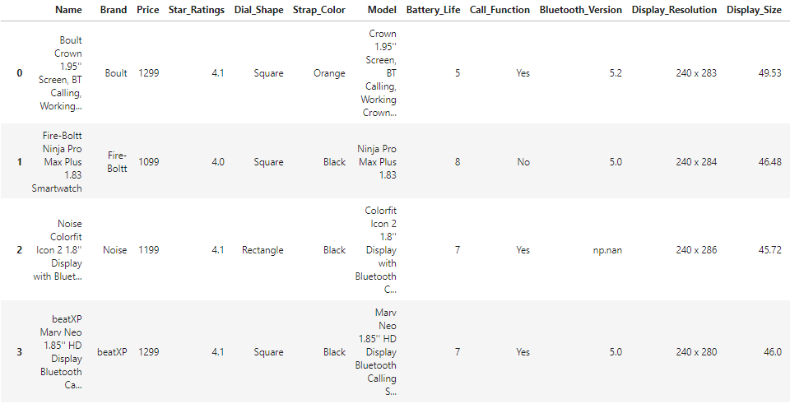
Overview of Collected Data

Slide 7
Challenges Faced
Extracting brand names from product titles
Consolidating varying specifications across different brands
Standardizing battery life data into a consistent days format
Collecting data from multiple URLs
Managing missing data effectively

Slide 8
Data Pre-processing
Regular Expressions
To clean and organize the scraped data
Backfill and Pad fill
To Handling missing or inconsistent data
Data transformation
Collecting data in empty list and convert into pandas DataFrame

Slide 9
Exploratory Data Analysis (EDA)
Visualizations (e.g., price distribution, feature comparisons, top brands)
Trends and patterns identified in the smartwatch market
Key insights from the data
Smartwatches with black straps and square-shaped designs are the highest-rated models, with Boult emerging as the leading brand offering the most options in this category.

Slide 10
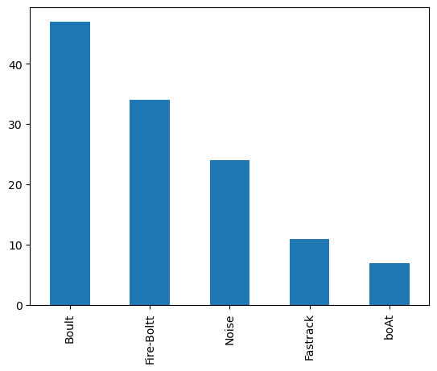
Visualizations
Top 5 Most Selling Brands

Slide 11
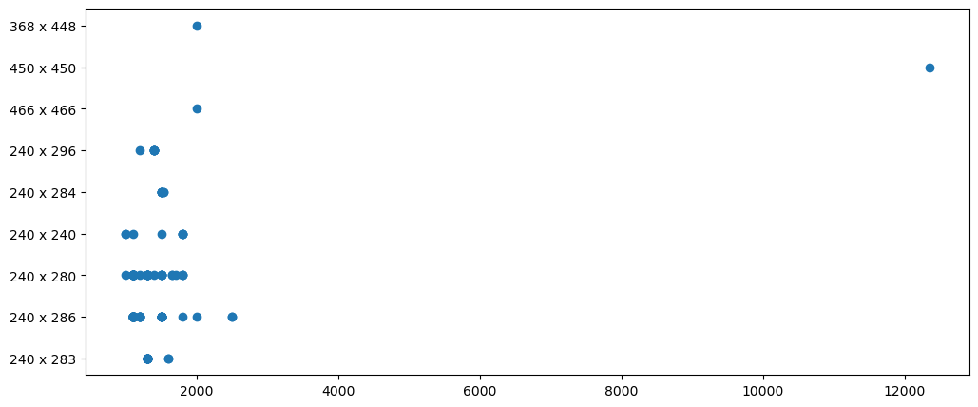
Price and their Display Resolution

Slide 12
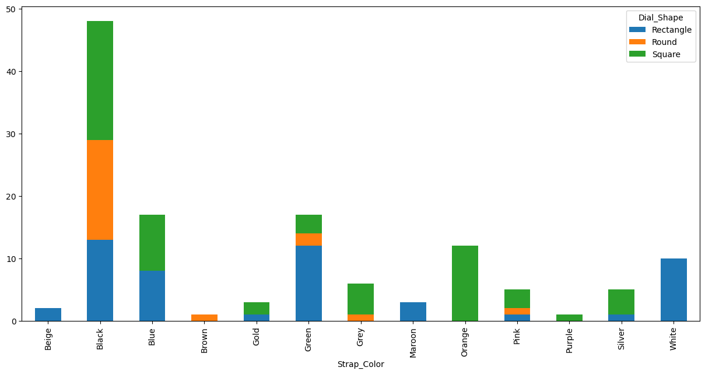
Color and their Dial shapes

Slide 13
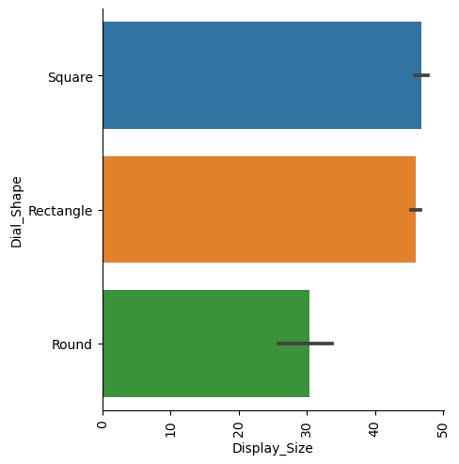
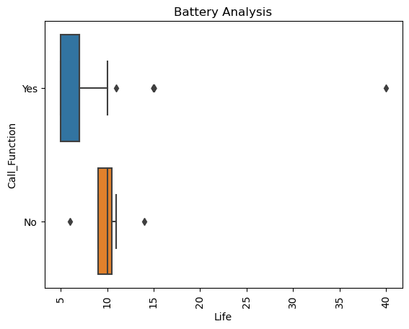
EDA Visualization of other features

Slide 14
Results and Findings
Summary of key findings from your analysis - Key findings reveal that rectangular and square-shaped smartwatches offer larger display sizes and higher resolutions. Watches with Bluetooth calling features generally have lower battery life compared to those without this feature. Additionally, most customers prefer smartwatches priced under ₹2000
How these findings align with your initial objectives - These findings provide customers with a comprehensive overview of the most popular smartwatches, including their specifications and price range, aiding in informed purchasing decisions.
Impact on decision-making or business strategies - These findings also assist brands in developing smartwatches within the identified price range and with similar specifications, thereby increasing sales, enhancing customer satisfaction, and optimizing profitability

Slide 15
Conclusion
This project has provided valuable insights into the smartwatch market, highlighting key trends and consumer preferences.
Rectangular and square-shaped dials are favored for their larger displays and higher resolutions, while watches with Bluetooth calling tend to have shorter battery life.
Additionally, a significant portion of customers prefers smartwatches priced under ₹2000.
By leveraging these insights, brands can strategically align their product offerings to meet market demands, enhance customer satisfaction, and drive profitability.

Slide 16
Q&A
Open the floor for questions from your audience.

Slide 17
Thank You

